Slide 1
Connect on DDD – Part II
Slobodan Sipcic
April 10, 2020

Slide 2
Table of Contents
Background and Goals
TFS Transformation to Mobility Service Provider
TFS Digital ‘mFin’ Architecture Playbooks
Goals of the Presentation
Domain Driven Design – Overview and TFS Example
DDD Finding Boundaries
DDD Modeling
Microservices Meet DDD Aggregates
Example: Insurance Servicing Decomposition
DDD & Service Design Needs & Playbooks Recommendations
Organizing Services Around Business Capabilities
Loosely Coupled Services
Instantiation of Services Through Templating
Deployment of Services in Minutes
Demo Time

Slide 3
Background and Goals

Slide 4
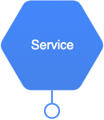
TFS Transformation to Mobility Service Provider
TFS is transforming to a Mobility Service Provider for internal and external customers, following a software as a product factory model. Embracing Services as a product approach facilitates a service ecosystem that enables rapid, frequent and reliable delivery of large, complex applications. It also enables TFS to evolve its technology stack in response to changing business needs.
To fulfill the above promises the Services need to be:
Organized around business capabilities
Loosely coupled
Independently deployable
Highly maintainable and testable
Note on notation:
In this presentation I will be using a Hexagonal Service representation
Also, I will assume that Services are exposed for consumption via RESTful API

Slide 5
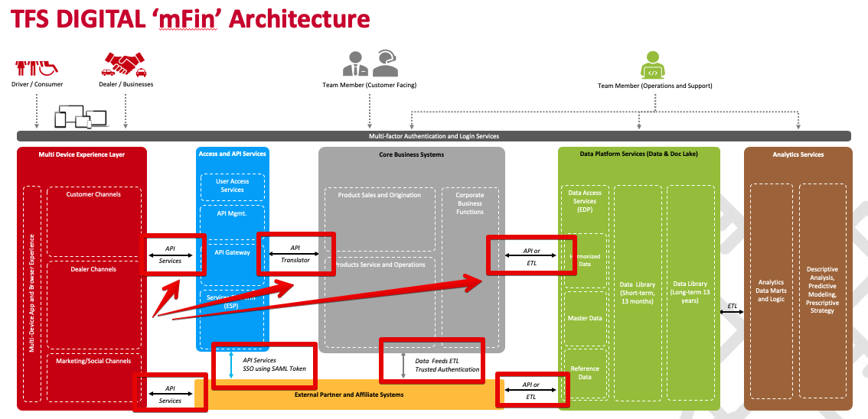
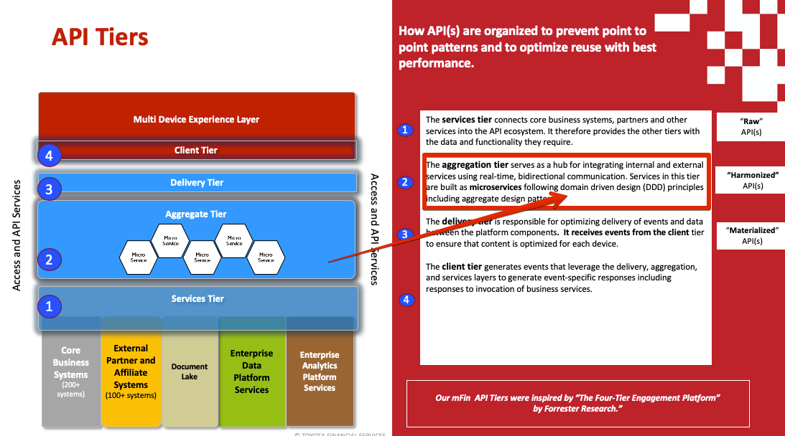
TFS Digital ’mFin’ Architecture Playbooks
TFS DIGITAL ‘mFin’ Architecture Playbooks provide a basis for realization of the TFS transformational goals. This presentation if fully aligned both with the words and spirit of the Playbooks.
“ …
All system to system integration use common mFin API standards and guidelines.
All customer-facing systems to integrate with non-customer-facing systems via mFin API Layer.
…“

Slide 6
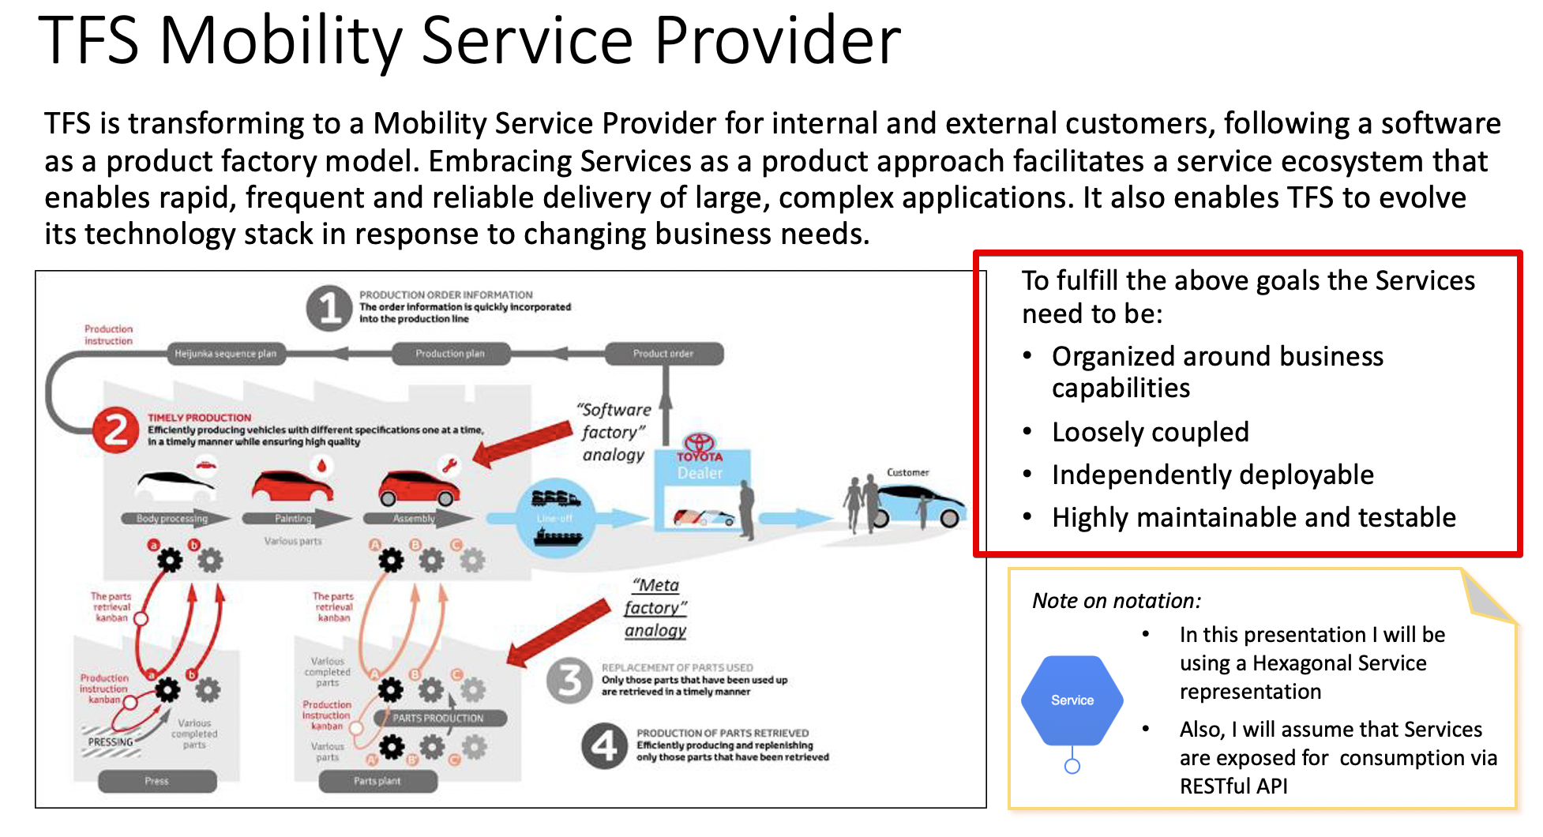
Goals of this Presentation
The main goal of this presentation is to document needs for further elaboration of the recommendations in the Playbooks related to realization of TFS Transformational goals and to show how Domain Driven Design (DDD) in conjunction with Microservice architectural style and Event Sourcing can be used to address these needs.
The plan is to:
Introduce Domain Driven Design in the context of the goal of this presentation
Analyze each of the Service needs in the light of DDD and propose additional Playbook elaboration steps to help realization of the needs

Slide 7
Domain Driven Design Overview and TFS Example

Slide 8
DDD Finding Boundaries
DDD is about designing software based on models of the underlying domain. As one tries to model a larger domain, it gets progressively harder to build a single unified model. DDD deals with large models by providing decomposition categories including:
Domains: A Domain defines a problem area for which the software is going to provide solutions.
Subdomains: DDD recommends splitting a Domain up into smaller parts called Subdomains and furthermore suggests categorizing Subdomains into Core, Supporting and Generic for easier identification.
Bounded Context: A Bounded Context delimits the applicability of a specific model. Integration across contexts boundaries involves some translations.
Context Map: A Context Map gives a global overview of the project’s contexts and the relationships between them.

Slide 9
DDD Modeling
DDD covers the general categories of objects that good object-oriented designers identify and work with. Those categories are critical elements of a good software design and include:
Entity: An Entity is an object that is distinguished by its unique identifier.
Aggregate: An Aggregate is a cluster of associated objects that are treated as a unit for the purpose of data changes. External references are restricted to the root Aggregate. Aggregates are the basic element of transfer of data storage – transactions should not cross aggregate boundaries.
Repository: A mechanism for encapsulating storage, retrieval, and search behavior which emulates a collection of objects. The Repository is the thing that "maintains the illusion" that all objects are in-memory and instantly searchable while it hides the messiness of the database implementation behind it.

Slide 10
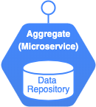
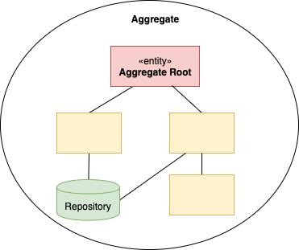
Microservices Meet DDD Aggregates
Microservices are borne out of peoples’ frustrations with monolithic applications. The microservice architectural style is an approach for developing an application as a suite of small loosely coupled and independently deployable services.
These microservices typically:
Have their own stack, inclusive of the database and data model,
Run in their own process and communicate with one another over a combination of REST APIs, event streaming, or message brokers.
Are built around business capabilities and are independently deployable by fully automated deployment machinery.
Support evolutionary design to allow for frequent, fast, and well-controlled changes to software.
DDD Aggregates meet Microservices:
The principles of Domain-Driven Design can assist microservice design through establishing Bounded Context, defining Aggregates and Repositories and then, using that information to define and design microservices.

Slide 11
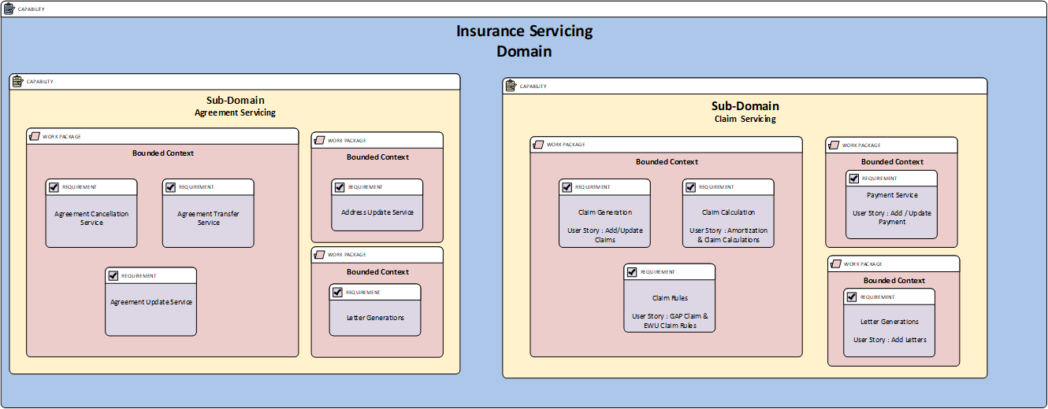
Example: Insurance Servicing Decomposition

Slide 12
DDD & Service Design Needs & Playbooks Recommendations

Slide 13
Organizing Services Around Business Capabilities
Antipattern: Use case specific APIs. Application of this antipattern results in API “sprawl” that impedes agility and ability of the architecture to evolve in response to changing business needs.
Point-to-Point “Spaghetti”
API “Spaghetti”
Goal: APIs that deliver generalized business capabilities based on application of DDD decomposition and related aggregates.
Recommendation: Update the Playbooks with steps to minimize the use and proliferation of this antipattern.

Slide 14
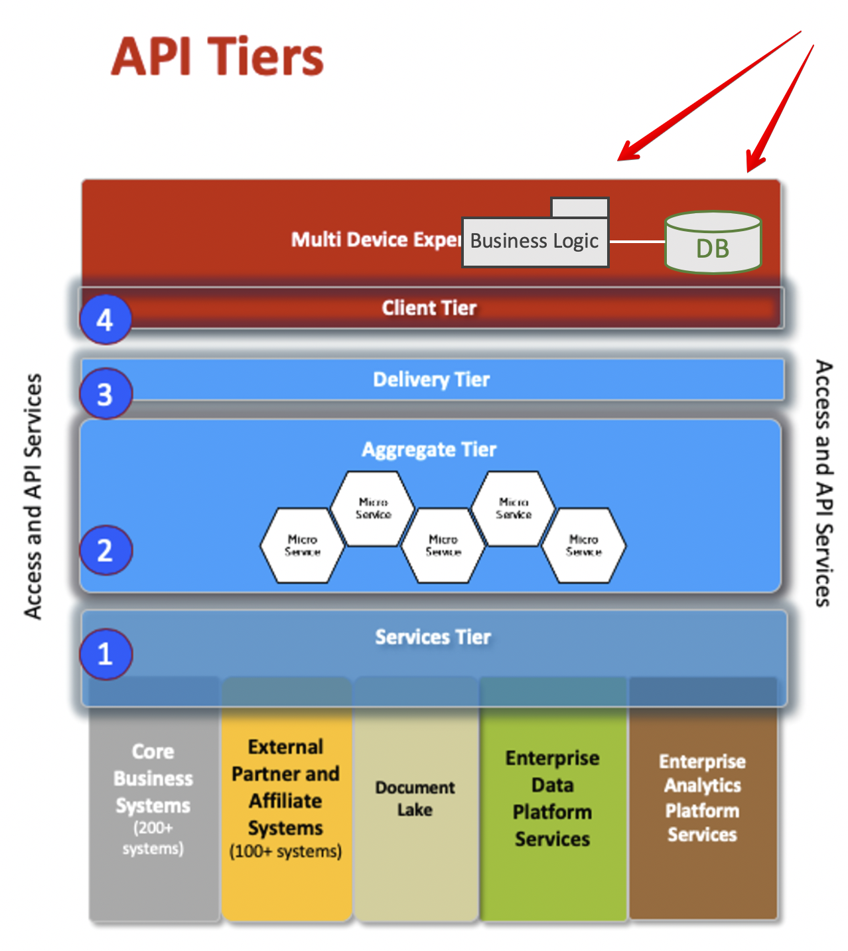
Organizing Services Around Business Capabilities
Antipattern: A Smart UI. This design implements a domain logic in an UI architectural layer typically coupled with use of a shared repository of the data. This is probably the most distractive design that violates all DDD principles.
Goal: Implement domain logic in Domain layer based on the DDD principle of separation of Domain and UI architectural layers. ﻿In fact, it is difficult to apply any of the methods of DDD without that separation.
Recommendation: Update the Playbooks with steps to minimize use and proliferation of this antipattern.

Slide 15
Loosely Coupled APIs
Antipattern: Tightly coupled APIs. Coupling might be at a business logic level as well as at a data level. Changes in a single API can have a system wide impact, with unanticipated and undesirable effects.
A
DB
B
B
Goal: Loosely coupled APIs. In a loosely coupled design APIs are independent, and changes in one will not affect the operation of others. Modeling APIs as DDD Aggregates helps alleviate the challenge.
Recommendation: Update the Playbooks with steps to minimize use and proliferation of this antipattern.

Slide 16
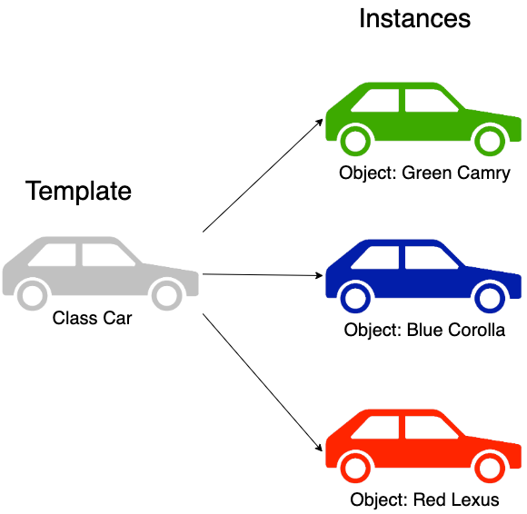
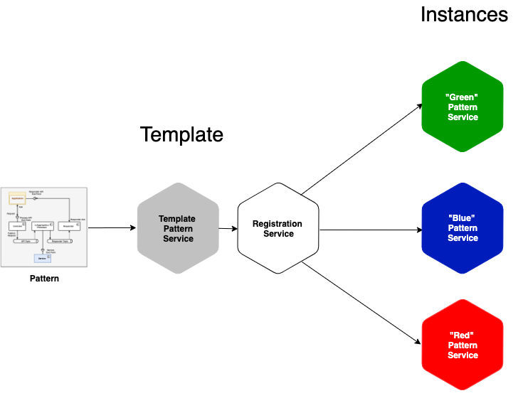
Instantiation of Services Through Templating
We create services from templates in minutes vs days!

Slide 17
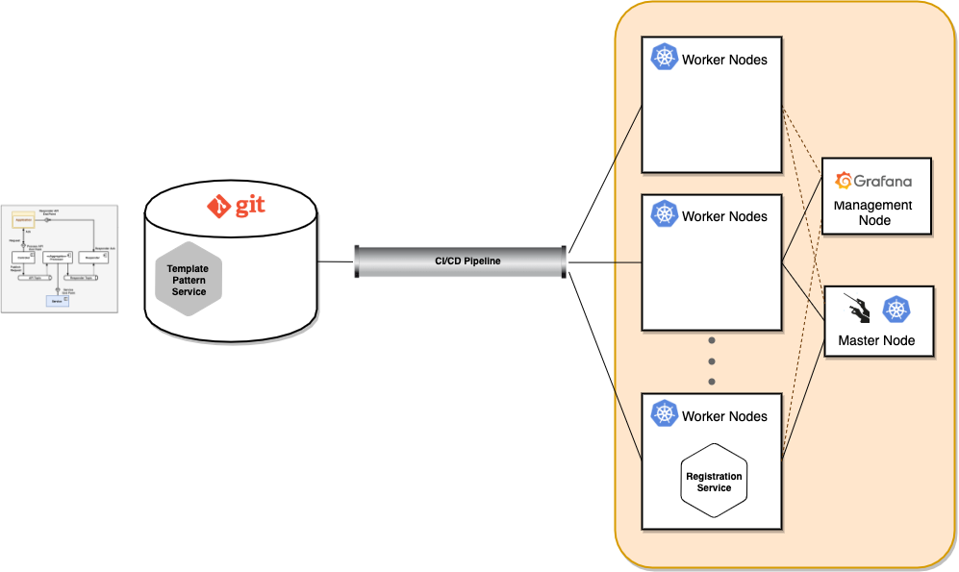
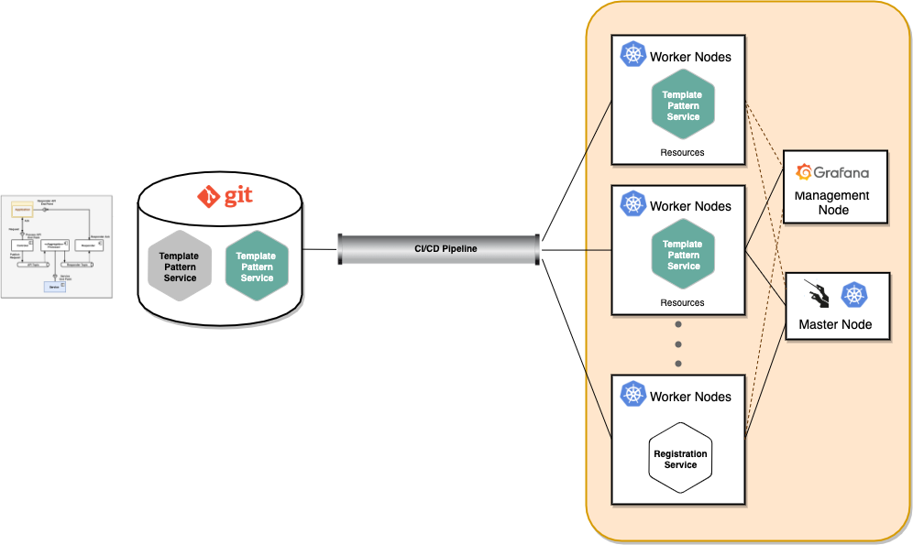

Deployment of Services in Minutes
This is how we do it.

Slide 18
Demo Time

Slide 19
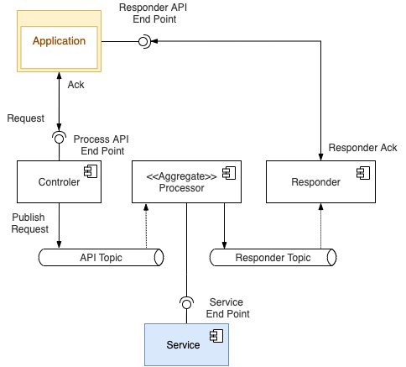
Asynchronous Pattern

Slide 20
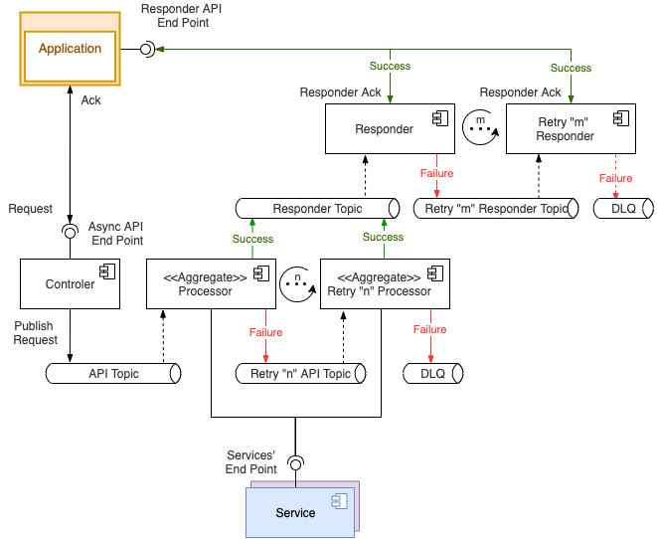
Asynchronous Pattern with Retries

